Slide 1
Credit EDA Study

Slide 2
Purpose
Credit Risk analysis plays a crucial role in making informed decisions for loan approvals based on an applicant's profile within a company. The process involves assessing various risk scenarios, and two primary scenarios are often associated with this situation:
1st : If the applicant is likely to repay the loan then not granting the loan could lead to a loss of revenue to the company.
2nd : If the application is unlikely to repay the loan, approving the loan could result in a loss of revenue for the business because the applicant would be viewed as a defaulter.
Analysis of the data has been performed on the Jupyter notebook.

Slide 3
Analysis Steps
Understanding the Data and its attributes.
Checking and handling the missing values.
Removing irrelevant data for apt analysis.
Checking for outliers and data imbalance.
Performing Univariate and Bivariate Analysis.
Merging the Application dataset and Previous datasets.
Data analysis by univariate , segmented univariate , bivariate analysis and correlation.
Conclusion and Recommendations.

Slide 4
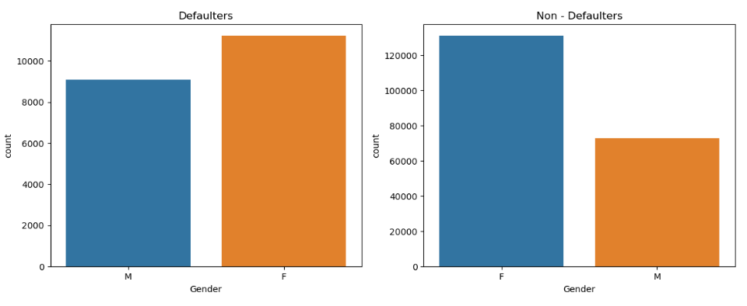
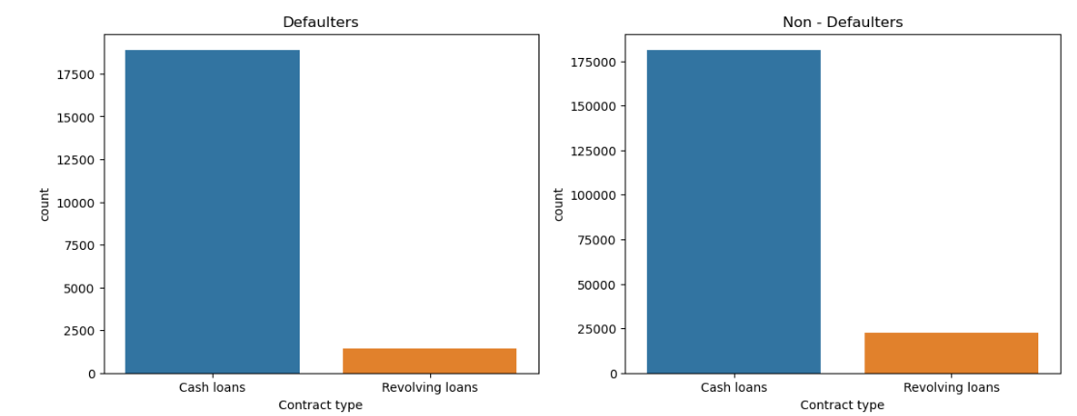
Analysis : The likelihood of a female being a defaulter is more as compared to males.
Analysis : We see a similar trend in the both the cases with the people with cash loans contract type likely to be a defaulter and a non- defaulter.

Slide 5
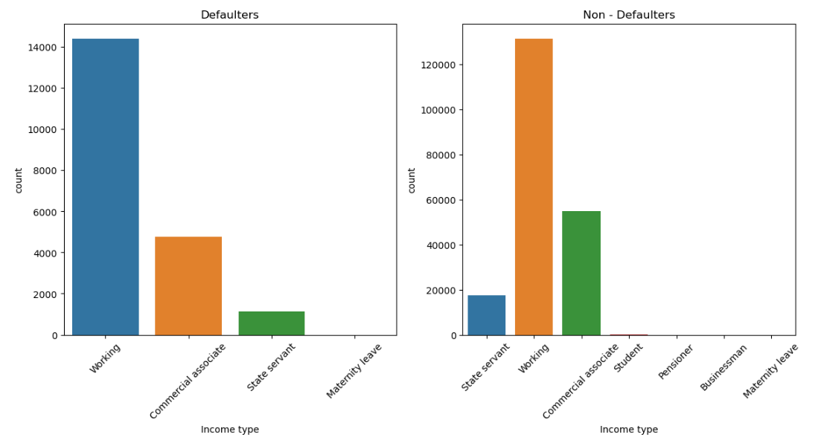
Analysis : In both the cases the working class is more likely to be a defaulter and a non-defaulter.

Slide 6
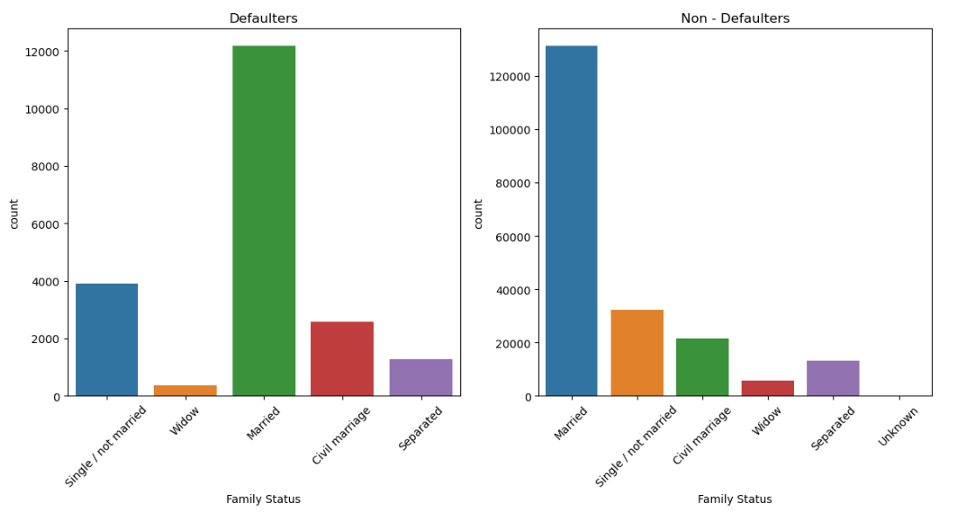
Analysis : For both the customers (defaulters and non-defaulters) married people are more in number compared with single, separated, widow etc.

Slide 7
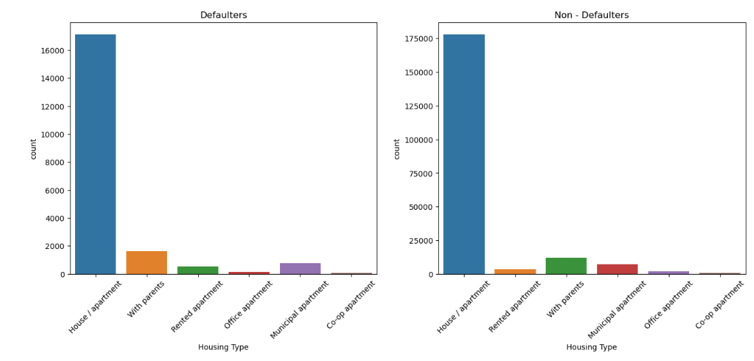
Analysis : The applicants with house / apartment housing type are comparatively a larger group as compared to the other housing types.

Slide 8
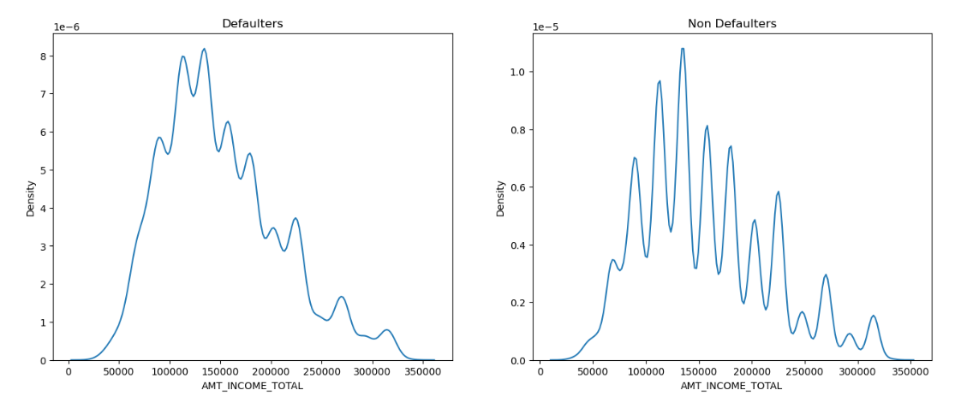
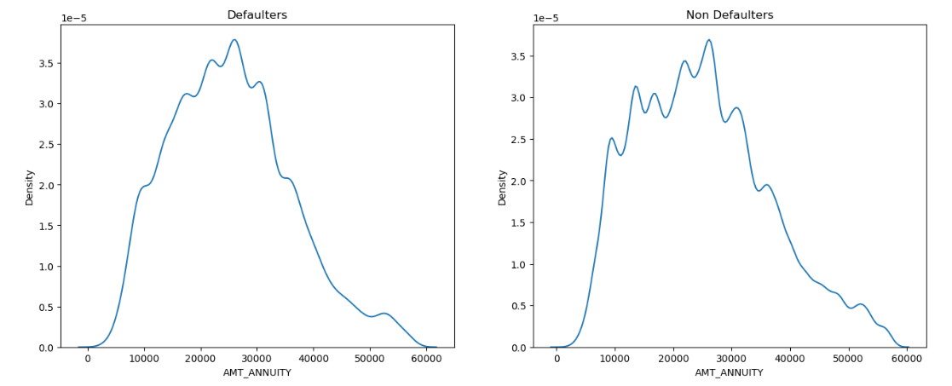
Analysis :The lesser the applicant’s income , the more likely it is for the applicant to be a defaulter.
Analysis : The applicants with Amt Annuity ranging from 20000 to 35000 are most likely to be Defaulters.

Slide 9
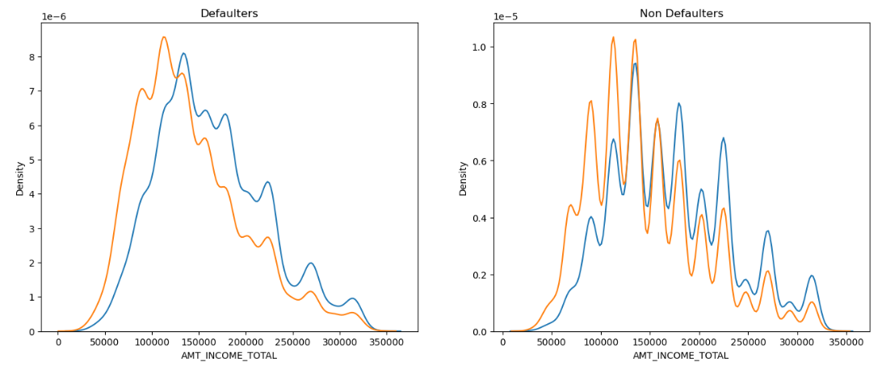
t
Analysis : We can notice by looking at the pattern that for being a defaulter both the genders (male and female) are almost equal in all income levels.
The spike of being defaulters is from 50000 to 200000.
In the case of Non- defaulters, Females are more non defaulter on the lower income level but lesser non defaulter in higher income level. The spike is more for both the genders from 75000 to 150000.

Slide 10
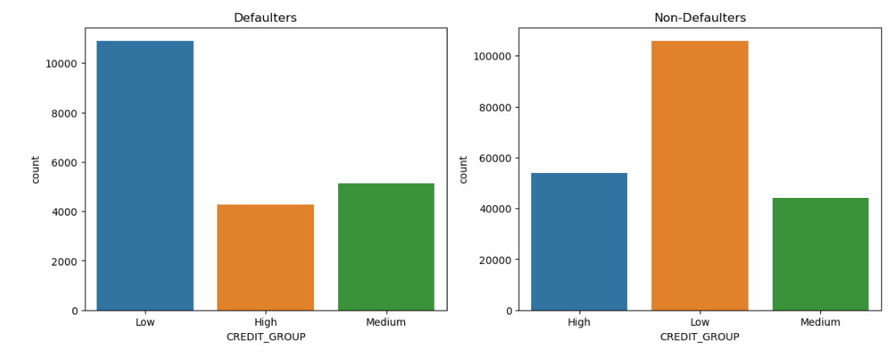
Analysis : In both the cases Defaulter, we observe the group with the lowest Credit is the most likely to be a Defaulter. Surprisingly low credited amount groups are more defaulters, whereas in the case of Non-Defaulters , w observe low amount groups are more in number, who were not defaulted.

Slide 11
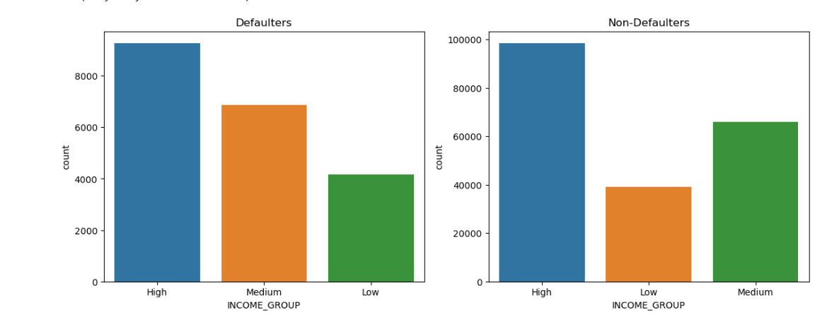
Analysis : The High income group is more in number to be defaulted, followed by Medium and then Low.
In the case of non-defaulters, the count of non defaulters more in High income group and less in low income group.
.

Slide 12
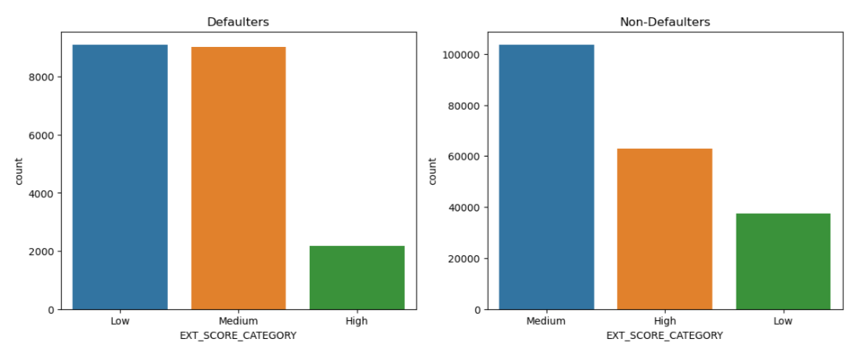
Analysis : Defaulters - No surprise that low scorer from external data source are more defaulters. Also, the medium scorer are as likely defaulter as low scorer.
Non defaulters - Medium scorers are no more defaulted than High scorer. As expected the Low scorers are lesser in number.

Slide 13
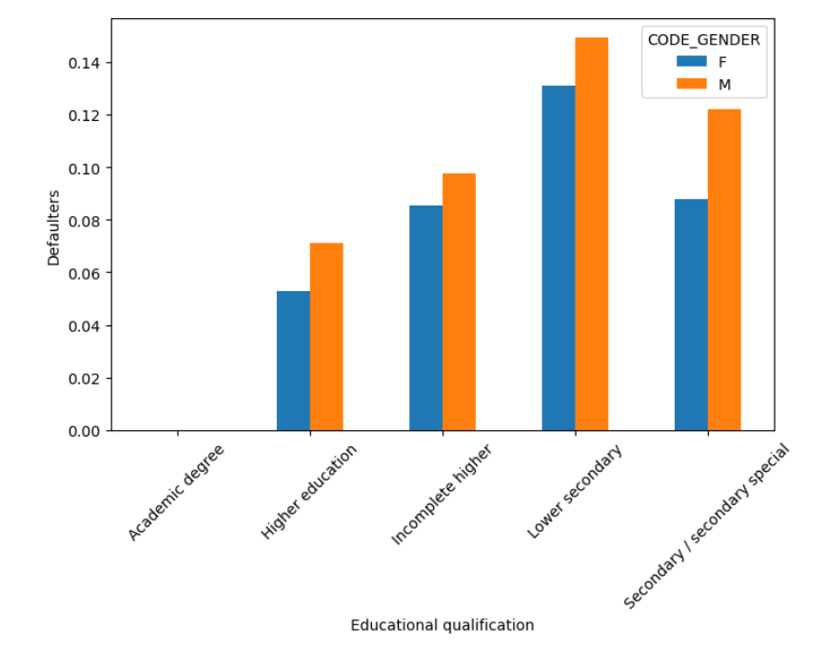
Analysis : The applicants with a higher educational backgrounds are less likely to be defaulters.

Slide 14
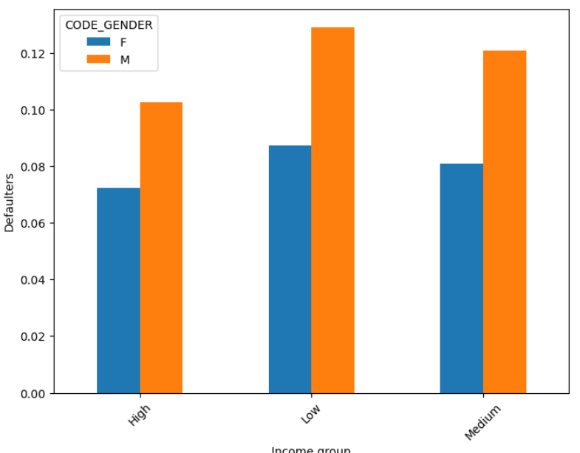
Analysis : Males are more likely to be defaulters as compares to the females .
Males with low salary range are most likely to be defaulters followed by medium range .

Slide 15
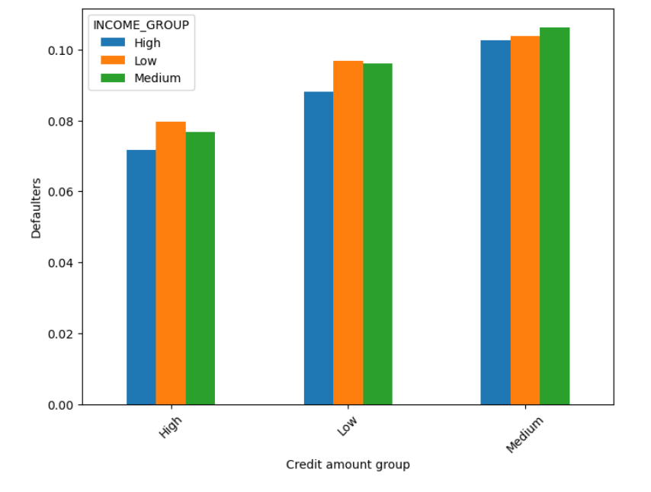
Analysis : Medium credit amount group are highly defaulted in all income groups whereas High credit amount groups are less likely to default in all income groups..

Slide 16
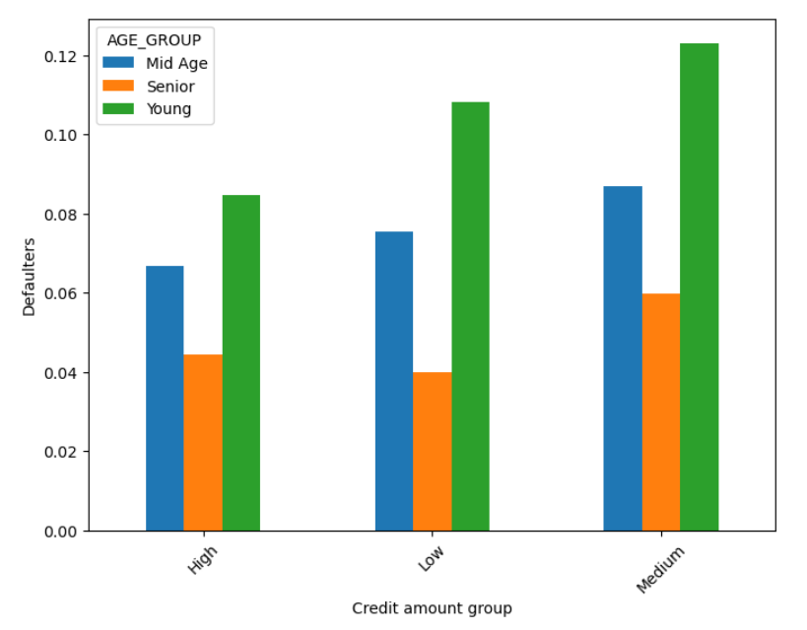
Analysis : The more the credit amount, the more likely a person is to be a defaulter, with young applicants being the most likely to.

Slide 17
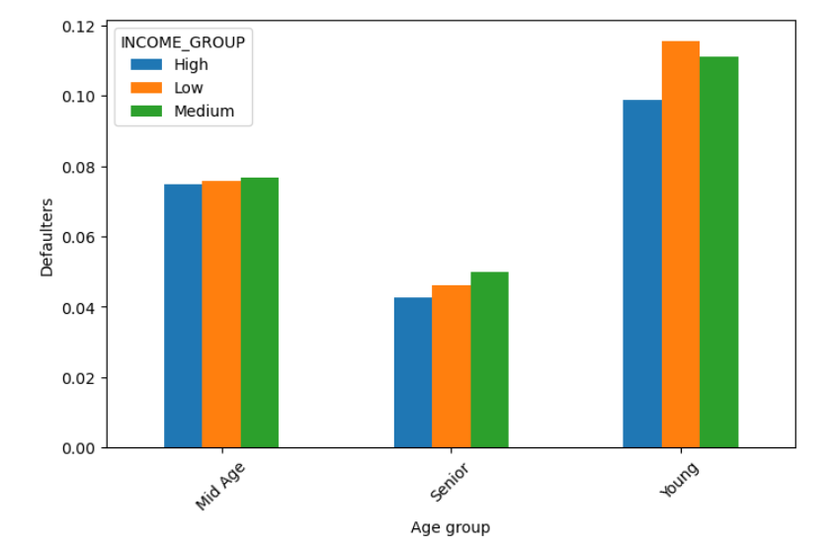
t
Analysis : The young people of any salary range are most likely to be defaulters, followed by mid – ages , then senior citizens.

Slide 18
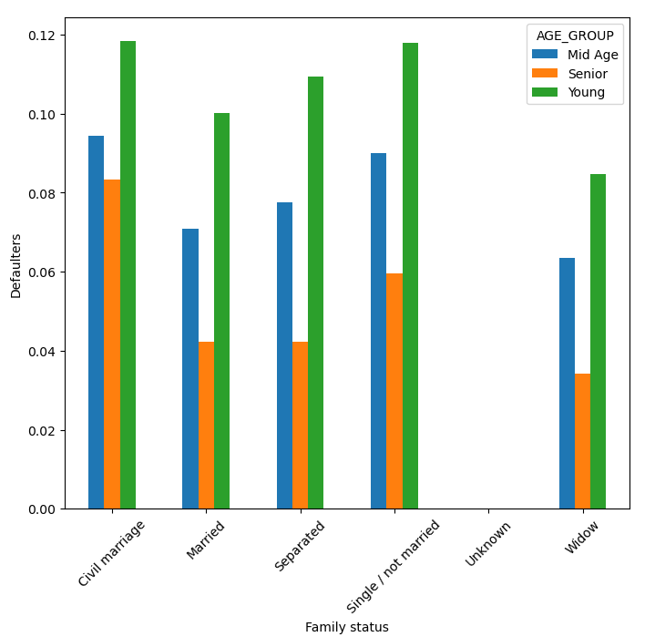
Analysis : Across all types of families , the young people are more likely to be defaulters

Slide 19
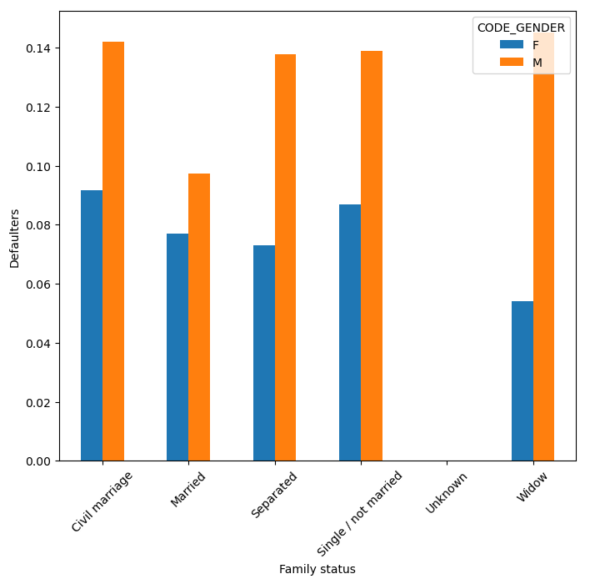
Analysis : Across all family status the Male clients are more defaulted than Female.

Slide 20
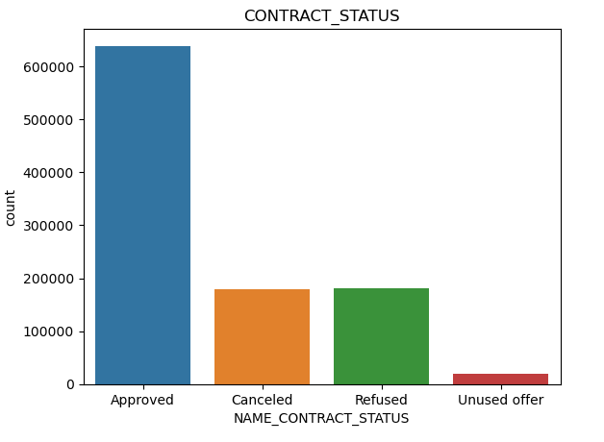
Analysis : From viewing above plot we can clearly say that Credit and cash offices were most efficient in acquiring client on the previous application.
.

Slide 21
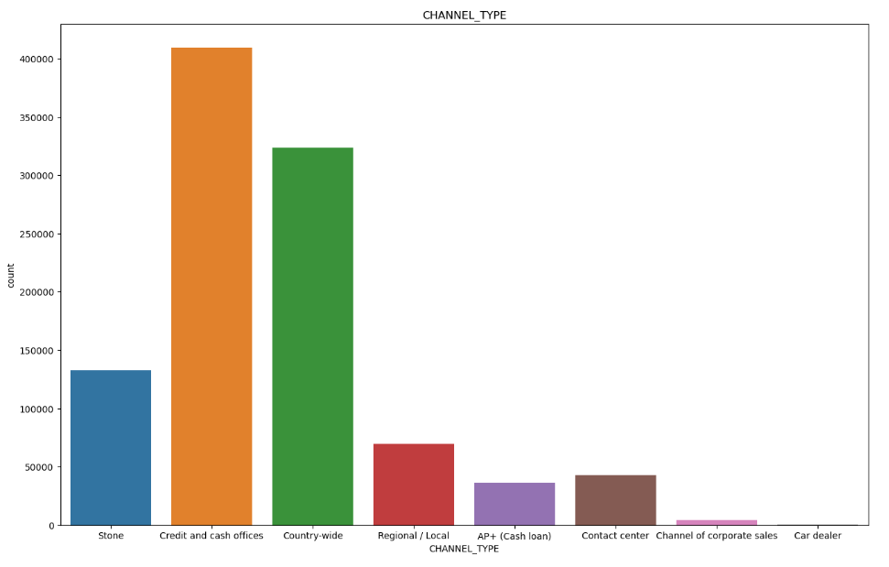
Analysis : From viewing above plot we can clearly say that Credit and cash offices were most efficient in acquiring client on the previous application.

Slide 22
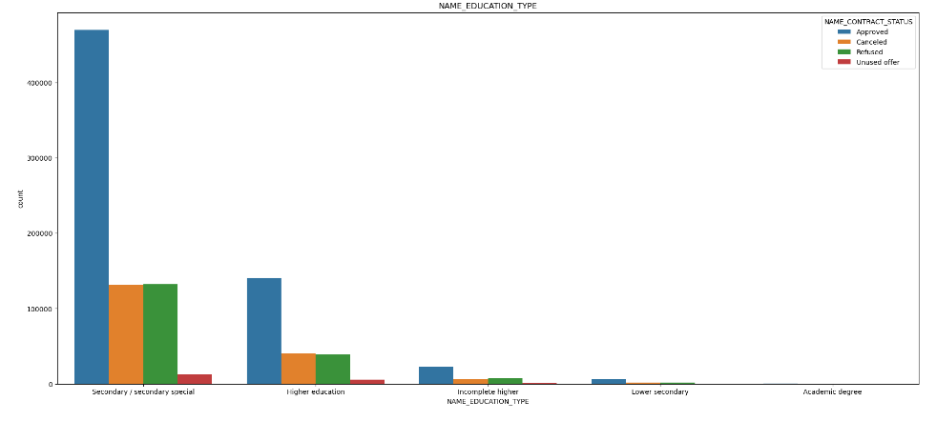
Analysis : Conclusion From the above plot we conclude that applications are more approved when clients education is "Secondary/Secondary special“.

Slide 23
Recommendation :
Credit and cash offices are most efficient in acquiring client so I would recommend company focus more on infrastructure of Credit and cash offices which would attract more clients.
The young people are most likely to be defaulters.
Higher the education background, the less likely is a person to be a defaulter.
The probability of a defaulter being someone from a low income group is the most .

